Slide 1



DESIGN AND CONTROL
2022년 7월 27일
HTTPS://GITHUB.COM/PHILBAEK/DESIGN_AND_CONTROL
LTSPICE
:Introduction
백형민
학부 연구생

Slide 2

INDEX
Why LTSPICE?
Basic Manual of LTSPICE
Useful techniques
Example

Slide 3



DESIGN AND CONTROL
LTSPICE INTRODUCTION
Why LTSPICE?

Slide 4

LTSPICE
SPICE-based Analog electronic circuit simulator
Most widely Used
Freeware ( !! )
No component limits
No node limits
You can use it on Mac Os
-> Better than other spice programs.
Notes:
이러한 subdomain을 mesh 라고 부름.
subdomain -> approximation.
마치 복잡한 함수를 짧은 interval에서 바라 보았을 때 linear equation인 것과 유사.

Slide 5
LTSPICE
A tool to simulate a circuit.
URL: https://www.analog.com/en/design-center/design-tools-and-calculators/ltspice-simulator.html
It is Open source.
Applications
DC and AC analyses are possible.
You can extract schematic files to construct PCB design or cad design.

Slide 6


DESIGN AND CONTROL
LTSPICE INTRODUCTION
Basic manual of LTSPICE

Slide 7
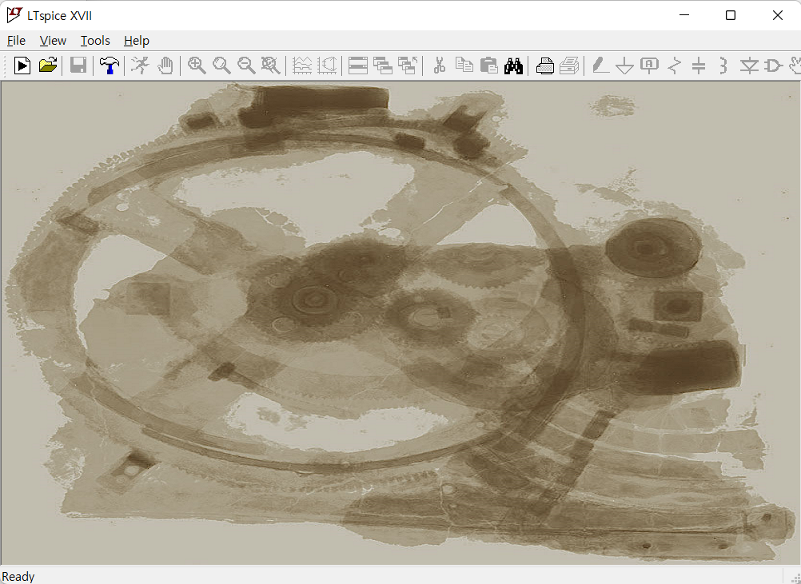
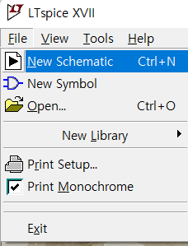
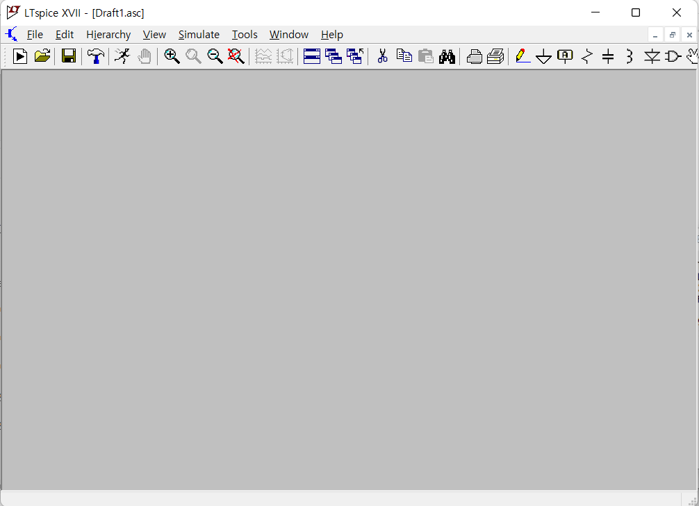
NEW SCHEMATIC
File -> New Schematic
Ctrl + N
Right Click -> New Schematic
Ready to draw

Slide 8
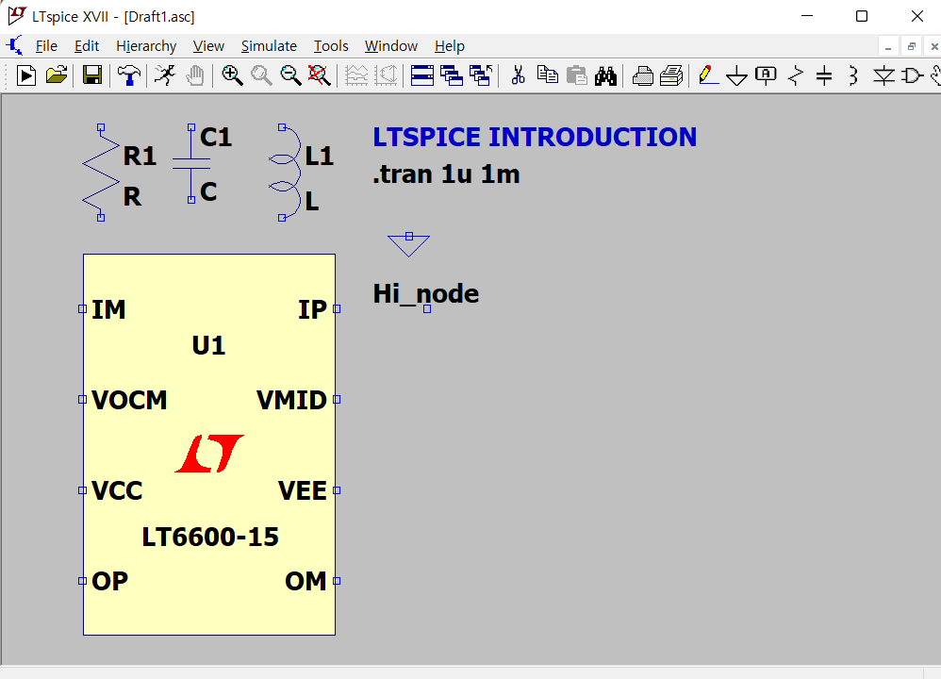
Shortcut keys
R: resistor
C: Capacitor
L: Inductor
D: Diode
G: GND
T: Text or SPICE directive
F2: PARTS Every component can be found here
F3: Wire
F4: Label Net VCC, VDD, GND, …
F5: Delete
F6: Duplicate
F7: Drag
CTRL+R : Rotate
CTRL+E : Mirror
Right Click on the background would show those options.

Slide 9
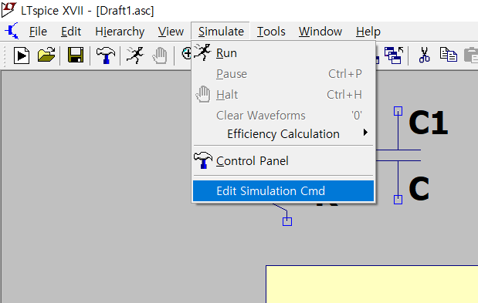
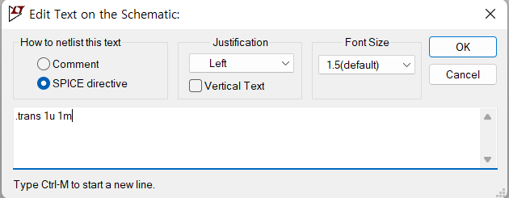
Simulation Setup
Simulate(Toolbar) -> Edit Simulation Cmd
Transient : DC and AC values are included. Time Based
AC analysis : Ignore DC Frequency Based
DC sweep : Ignore AC
If you are on MAC OS, then you should know the SPICE directives. SPICE directives can be written by using the ‘T’ key. If you check the ‘SPICE directive’ box, then the text is interpreted as a spice directive.

Slide 10
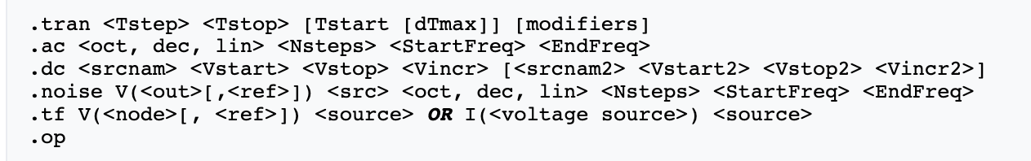
Simulation Commend
The commends above are the simulation commends.
‘tran 1u 1m’ means that the circuit’s analysis is the transient mode, stopping on 1ms with 1us time steps.
Details are in the link: https://ltwiki.org/index.php?title=Simulation_Command
If you are not on MAC OS, then those procedures can be aided by using ‘Edit Simulation Command’
Cautions.
For a lot of electronic circuits, small fluctuations are neglected on large time steps.
If those ignored data are important, then large time steps should be avoided.
Nevertheless, small time steps require much time to simulate.
Thus, choosing desirable Tstep and Tstop is essential.

Slide 11
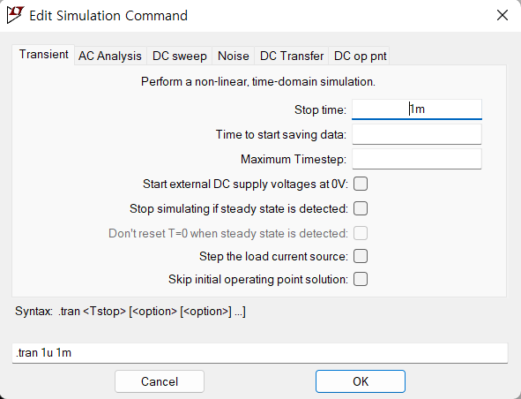
Edit Simulation Command
Edit Simulation Command provides efficient interfaces.
Transient Simulation initially starts with finding operating points.
In other words, a DC solution should be sought first.
Thus, ‘Skip initial operating point solution’ can be an option if your transient simulation stays in ”Damped Pseudo-Transient Analysis”, which means that the DC solution can not be found.
AC Analysis can be applied to get frequency information, such as a bode plot.
DC sweep analysis provides simulation output on changing VDC value, ignoring AC value.
In our cases(e.g., SMPS), the frequency of the voltage source is fixed, we will focus on transient simulation only.
Further explanation would be provided if it is needed.
Cautions.
‘Skip initial operating point solution’ should be treated carefully.

Slide 12



DESIGN AND CONTROL
LTSPICE INTRODUCTION
Useful Techniques

Slide 13
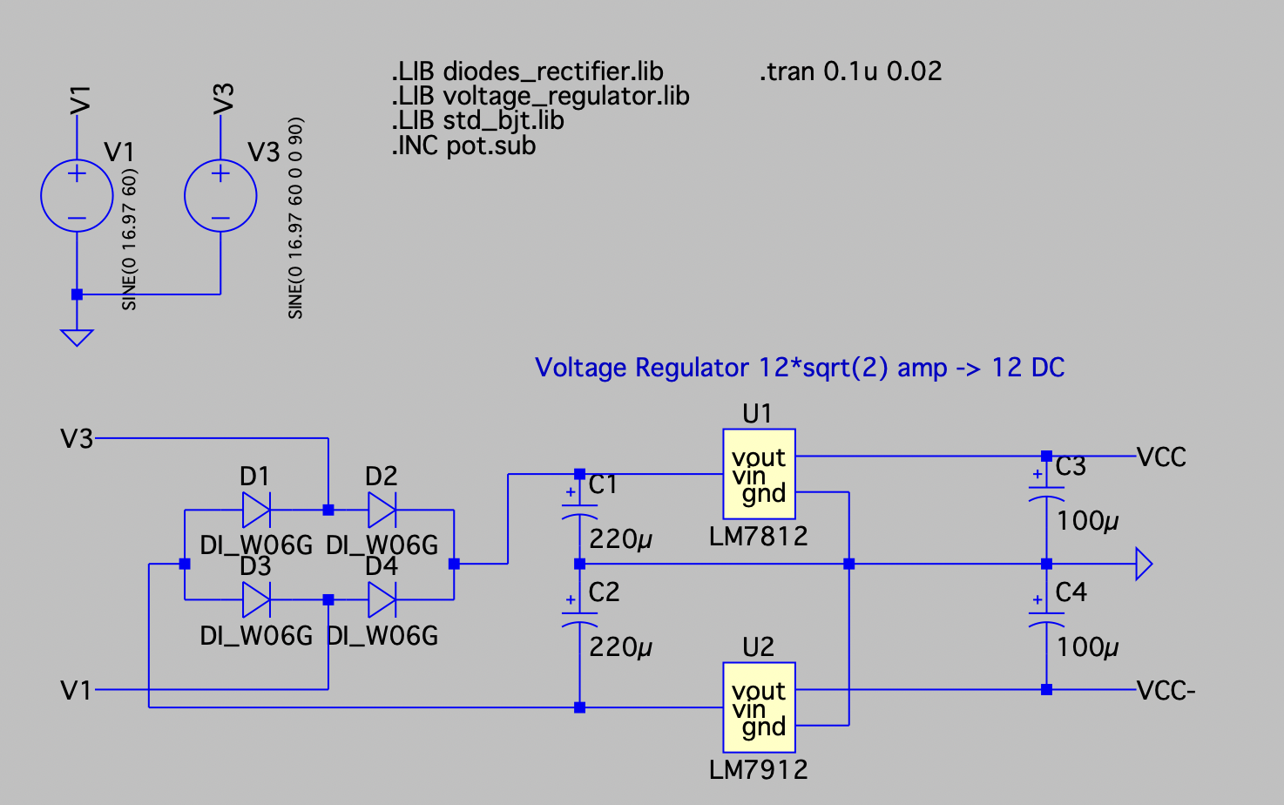
Importing Parts 1
It is impossible to provide every component’ information.
However, many companies provide SPICE model for the components.
For example, as you can see from the left, we want to use W06G voltage rectifier. But LTSPICE do not provide given diode specification.
It is easy to find W06G specification from the web.
https://github.com/peteut/spice-models/blob/master/diodes/diodes/diodes_bridge-rectifiers.txt
The txt file clarifies the specification of the spice model of W06G. As you can see, it is defined as diode.

Slide 14
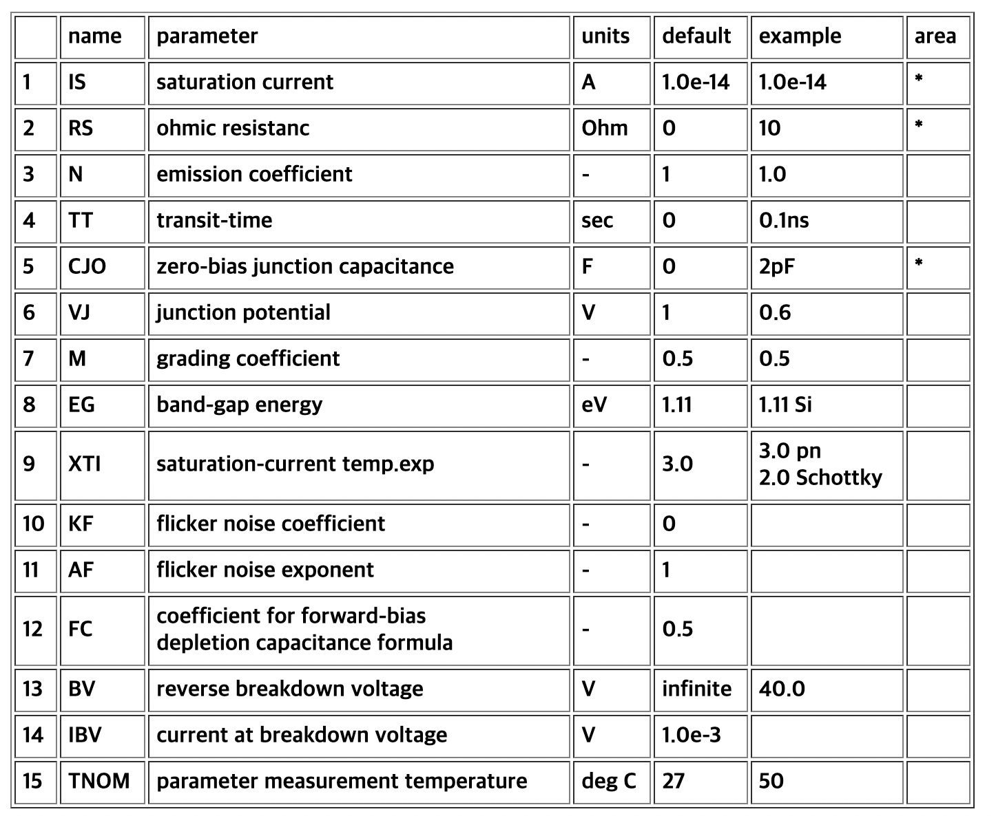
Importing Parts 1
The left table shows the spice model parameters.
Its value varies according to component’s properties.
Also, those parameters are totally different if the components are different. (e.g., NMOS, PMOS)
Since we could approach the library files, we can make our own diode.
If you get desired SPICE model .txt, you should save it as .lib or .sub files. (Just change the name)
Duplicate the file and put it in the path below.
Program Files -> LTC -> LTspiceXVII -> lib -> sub.
Sub folder is for the sub and lib files.
Sym folder is for the symbol files(.asy).
Cautions
If you want to use the schematic with another person, you should provide the custom library used before. If not, the schematic that you give would not work.

Slide 15
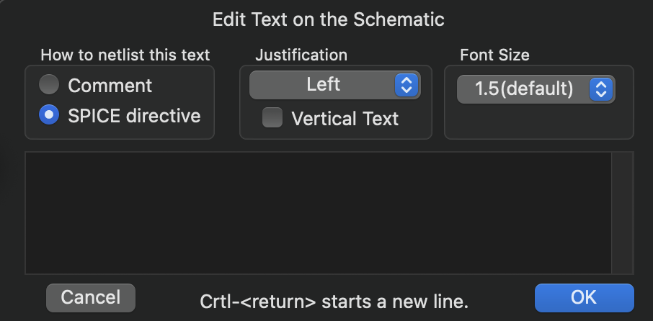
Importing Parts 1
After the preparation, you could include the .lib and .sub files.
In ‘Spice directive’ messages, .LIB functions as including .lib files and .INC include whole files, regardless of whether it is .lib or .sub files.
SPICE directive format : .LIB <filename> lib
.INC <filename> extension
After importing the library or .sub, change the existing model’s name. For example, the figure left shows the changed name of diode, that is, DI_W06G.
Cautions
.LIB function only reads .lib files, thus if you save the file with .sub extension, then you should use .INC function.
One .LIB can have more than one Spice model.

Slide 16
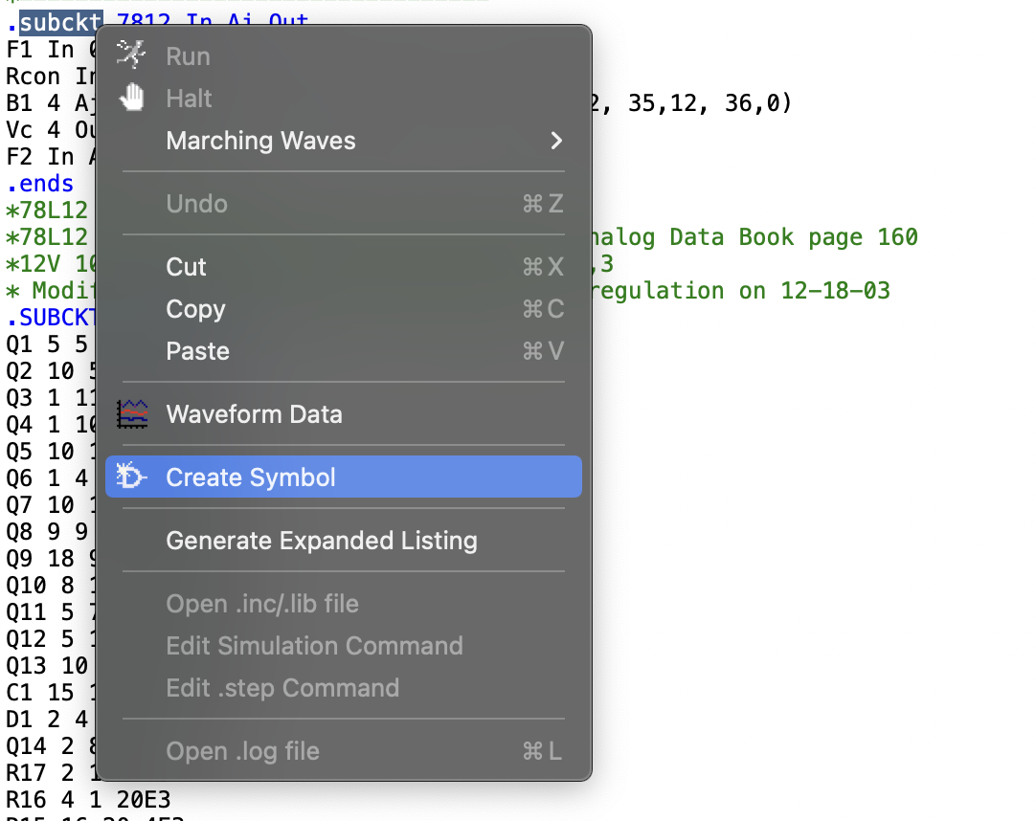
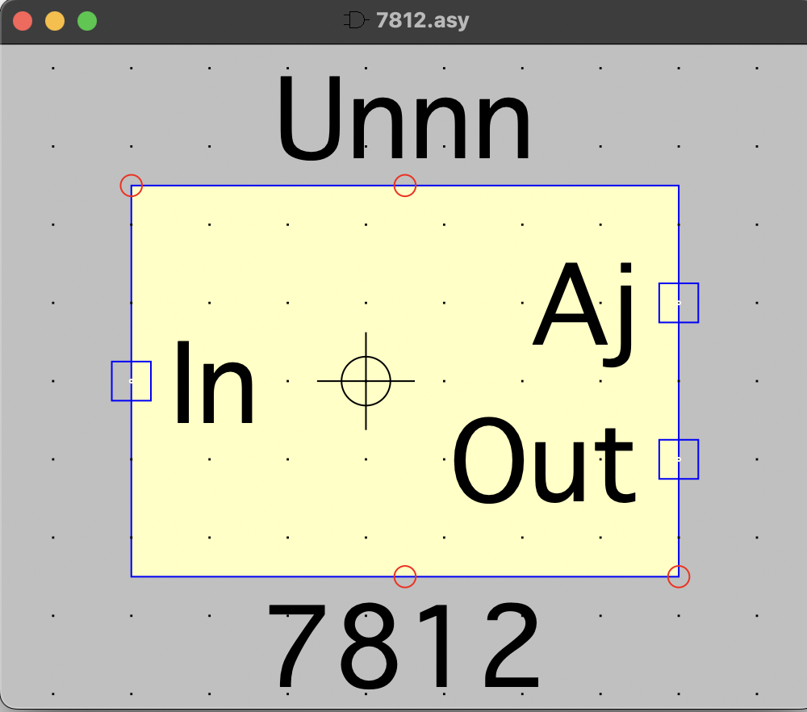
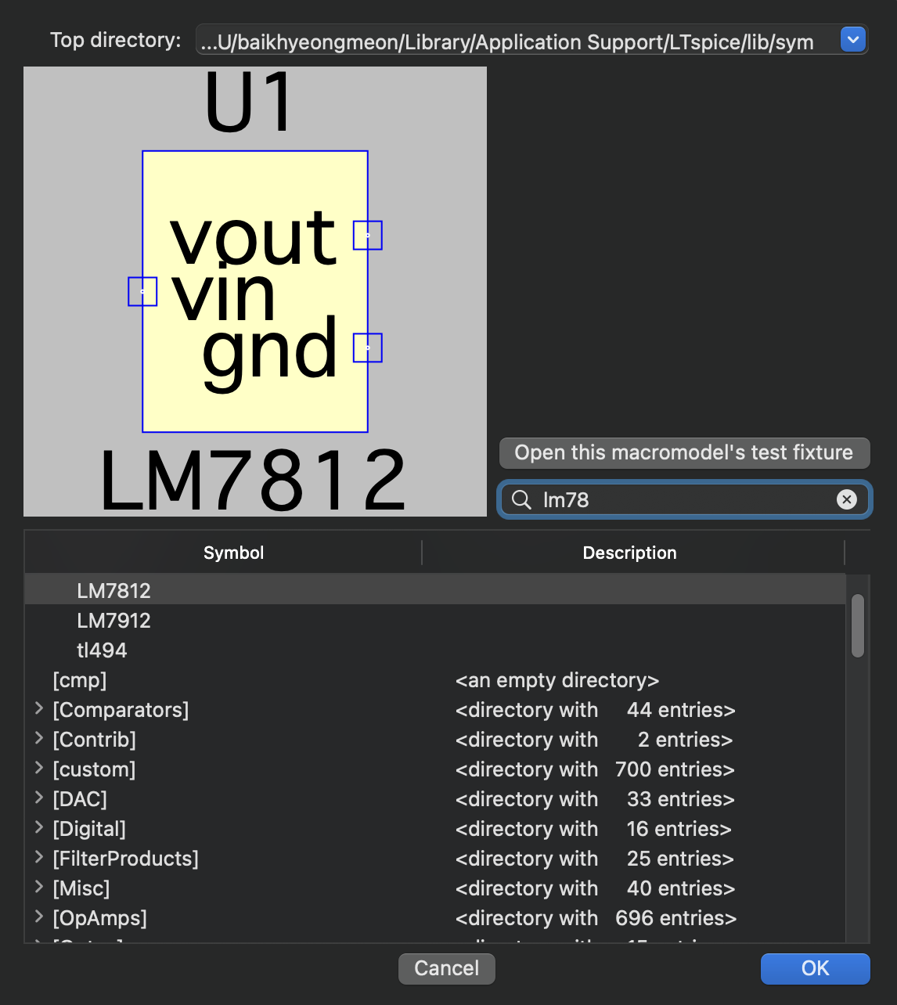
Importing Parts 2
‘Importing Parts 1’ works only for the existing symbols. Sometimes, there is a SPICE model which does not have desirable symbols. From the past figure, U1 and U2 are the examples. It is possible to rename the existing diode, but we do not have LM7812 and LM7912 symbol. Those models can be made easily.
Open the corresponding library file, inside the correct path Program Files -> LTC -> LTspiceXVII -> lib -> sub. You should open the lib or sub file using LTSPICE not text editor.
Find your component’ .subckt or desired format of your component.
As the figure left, you could make the symbol directly.
From the .asy window, after proper amendment such as changing port name, save the component.
After the procedure, you could find your own part from F2.
Cautions
You could make the symbol first. However, the method above generates port specification simultaneously, making the process much easier. Also, the library and schematic does not conflict if you follow the method above. Consequently, I recommend to follow the process above.

Slide 17
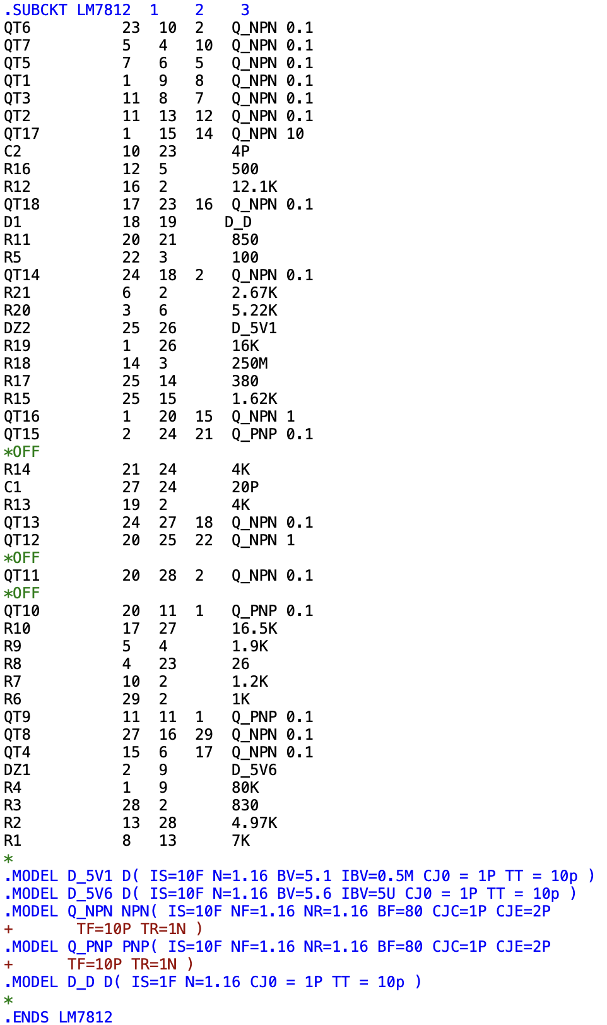
About .SUBCKT
Complex spice models can not be designed with one component such as D(diode). Generally, sub circuit is used to make the reliable component. As you can see from the left, QT6, …, QT17 are the name of Q_NPN component. Since Q_NPN should be specified, you could find out that they model Q_NPN as NPN.
In conclusion, SUBCKT help the component to be divided into smaller pieces. After that you could model the smaller parts that you know.
Those numbers (23 10 2) represents each part’s pin in and out. Now, LM7812 has three ports (1 2 3). You should carefully check the (1 2 3) port, whether it is VCC, GND, or so on.

Slide 18

DESIGN AND CONTROL
2022년 7월 27일
HTTPS://GITHUB.COM/PHILBAEK/DESIGN_AND_CONTROL
THANK YOU
백형민
학부 연구생

